Slide 1
Packard Power Rankings Development
By: Peter Campbell, Daniel Fishbein, and Clayton Hodges

Slide 2
Introduction

Slide 3
Website, GitHub, Documentation, Local Setup
Website
Rankings of specific Colorado sports and teams for win/loss predictions based off of the algorithm created by Dr. Packard
Github was used for the development of the web app
This was also used in the AWS Lightsail server to pull and add our changes to the site
Made it quick to implement changes and to add to the server side
Documentation
The documentation that was available was helpful in understanding the traversal of the actual web app itself
Useful directions on how to deploy changes to the actual server and what to do when something was not working
Local Setup/Development
Deployment of the web app as a mock for development purposes

Slide 4
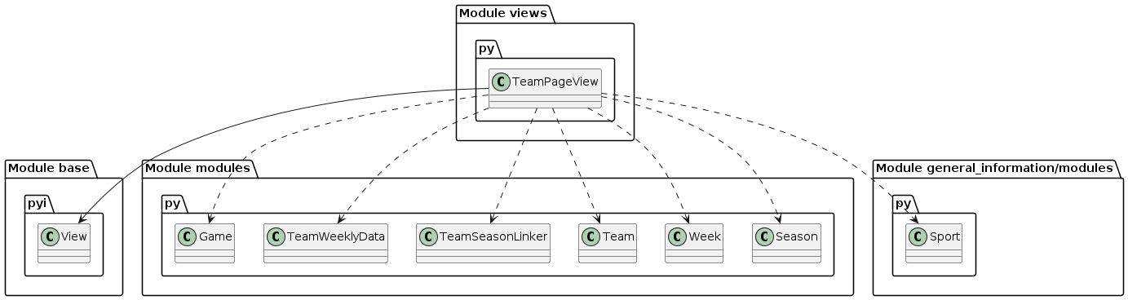
UML Diagrams: Development View

Slide 5
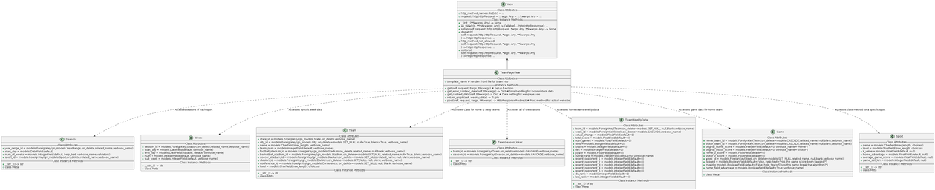
UML Diagrams: Logical View

Slide 6
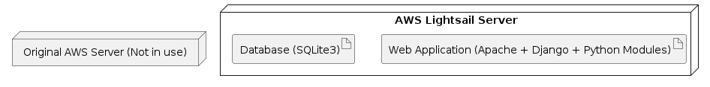
UML Diagrams: Physical View

Slide 7
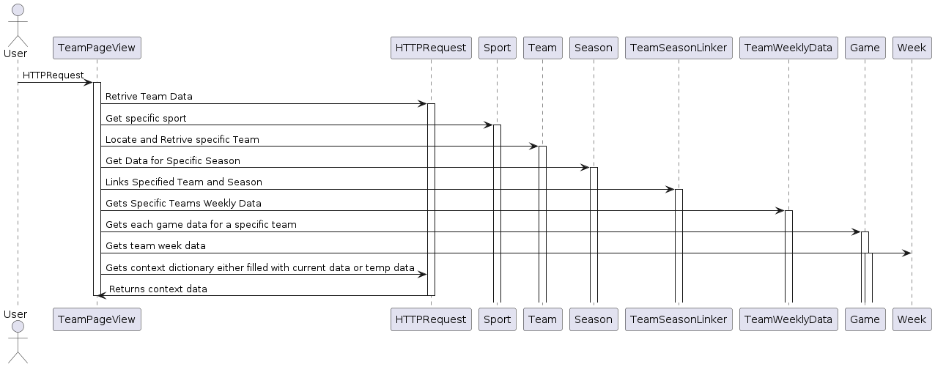
UML Diagrams: Process View

Slide 8
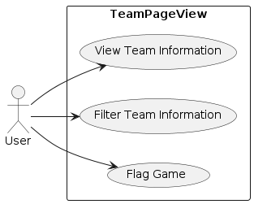
UML Diagrams: Use Case

Slide 9
Issue #172 Team Data and Graph
First issue that my team and I chose to work on
Mainly focused on finding where we could optimize code so we could increase server load times
Since the entire website is split into six different sites we chose to work on a sport that was out of season to see what we could do to improve site performance
Implementing changes to Packard Power Rankings
Small changes that we made to the site as per the client’s request was easily implemented to the site
Increase in server load time as we got rid of unnecessary imports.
Removed unwanted information
Cleaned up website for the individual teams information

Slide 10
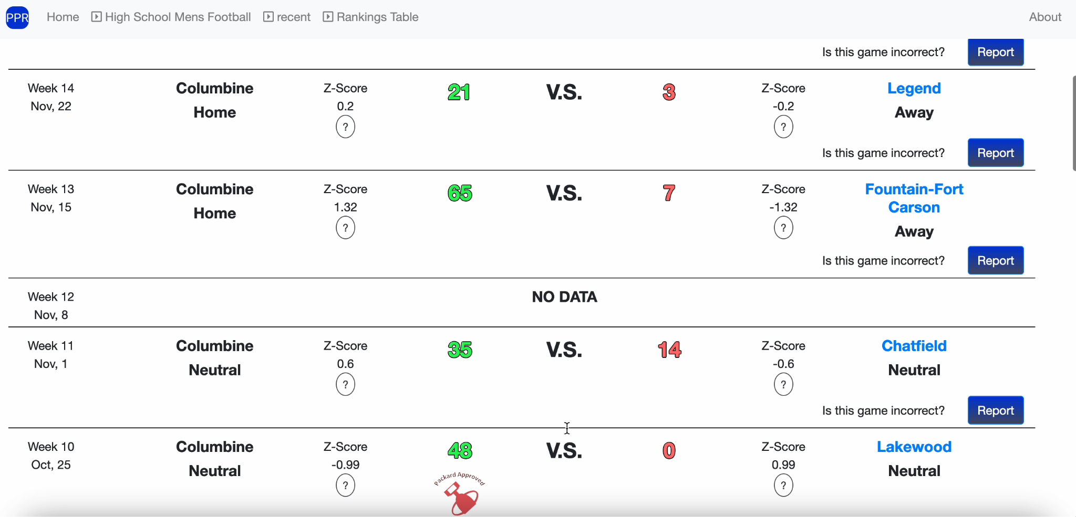
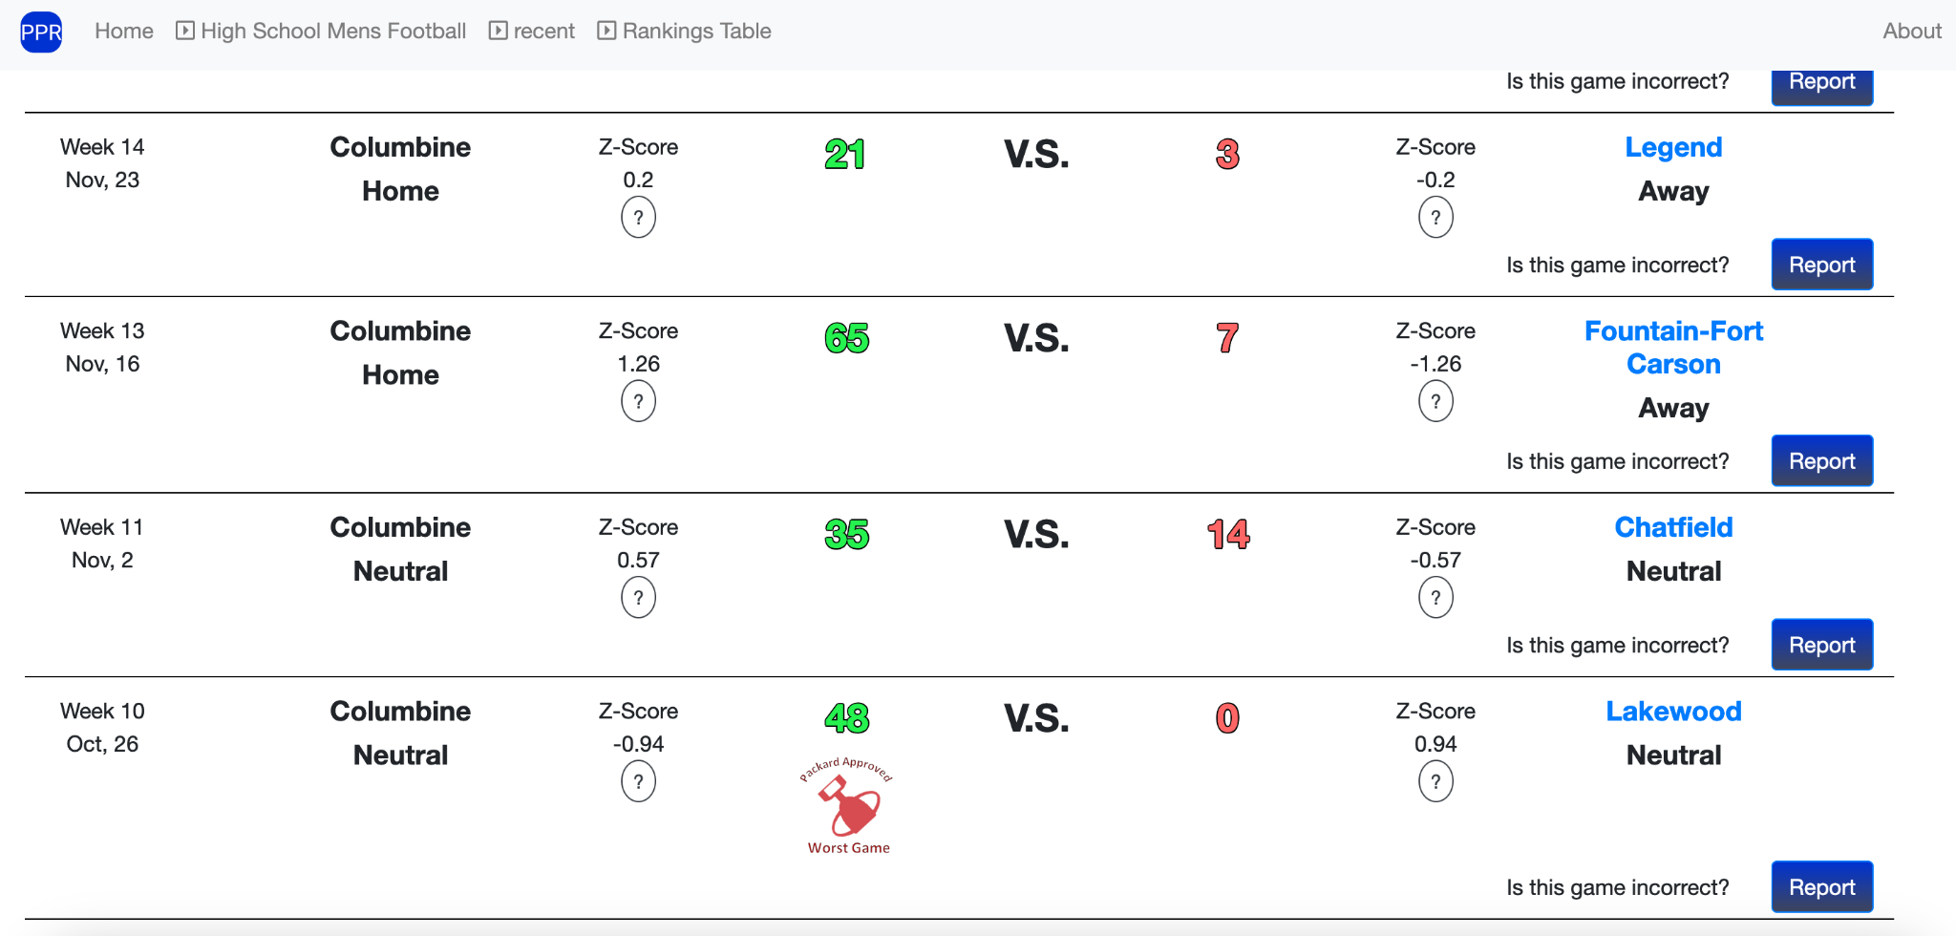
Portions Changed

Slide 11
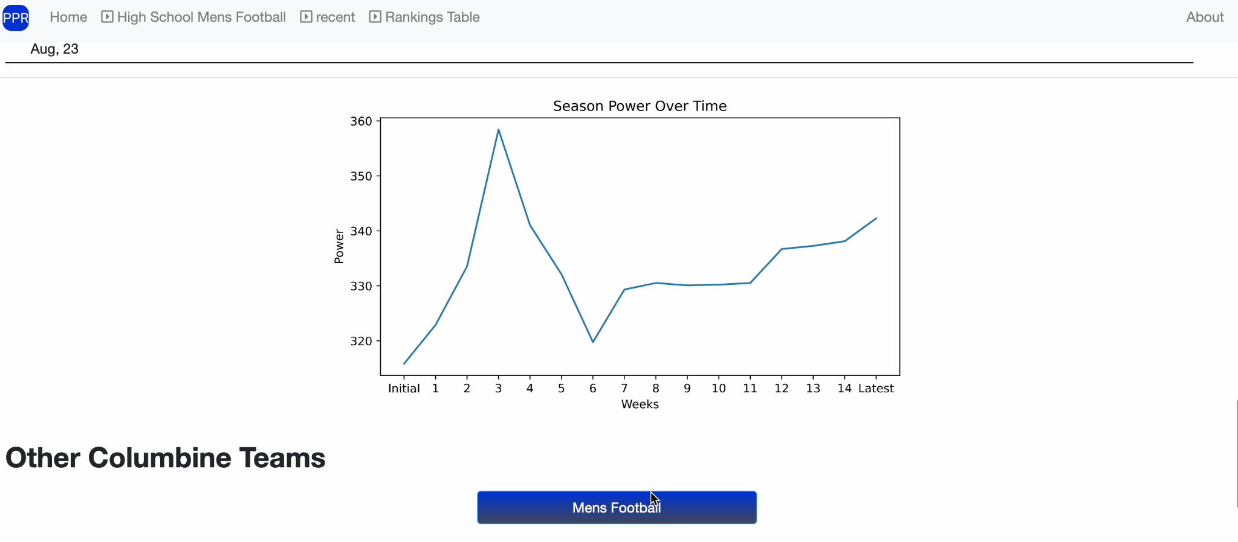
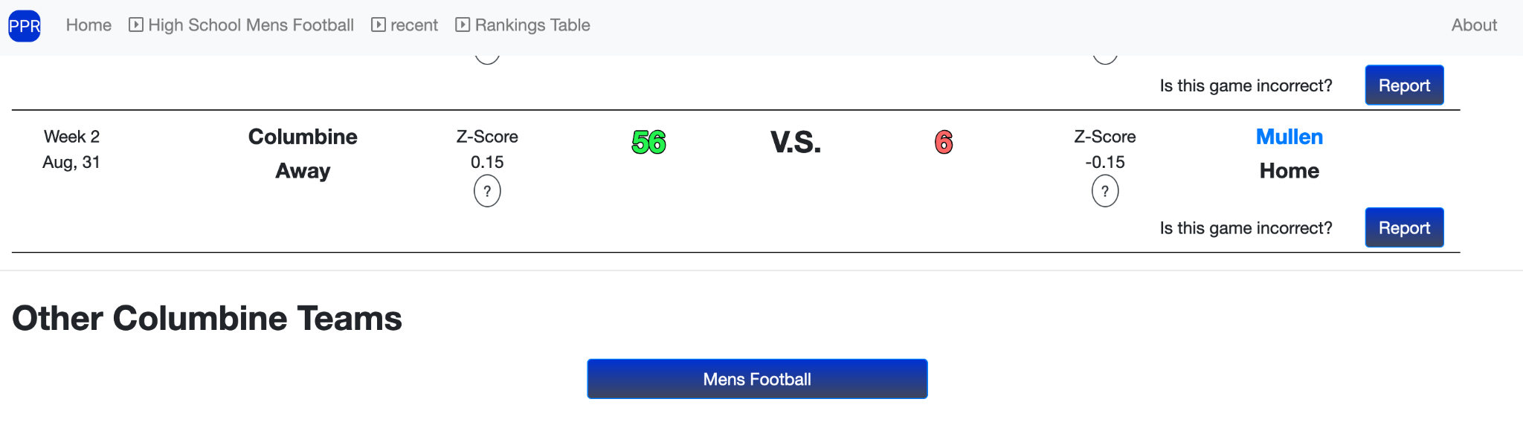
Portions Changed

Slide 12
Development

Slide 13
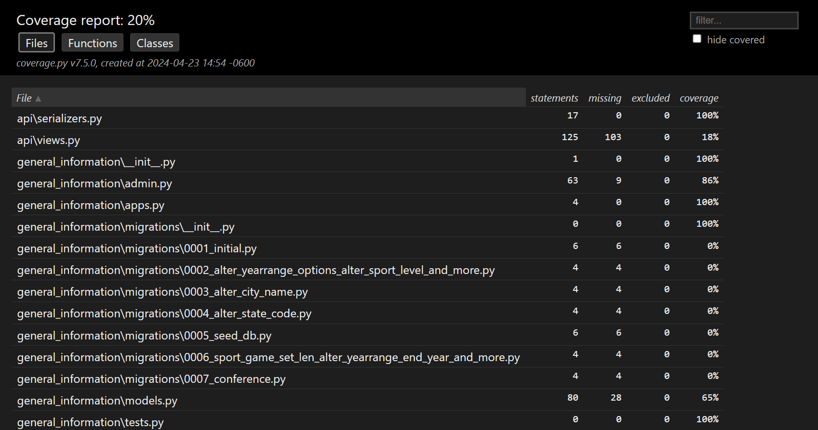
Test Coverage Report
80% of the website code has no testing.
There should be at least 50% test coverage.

Slide 14
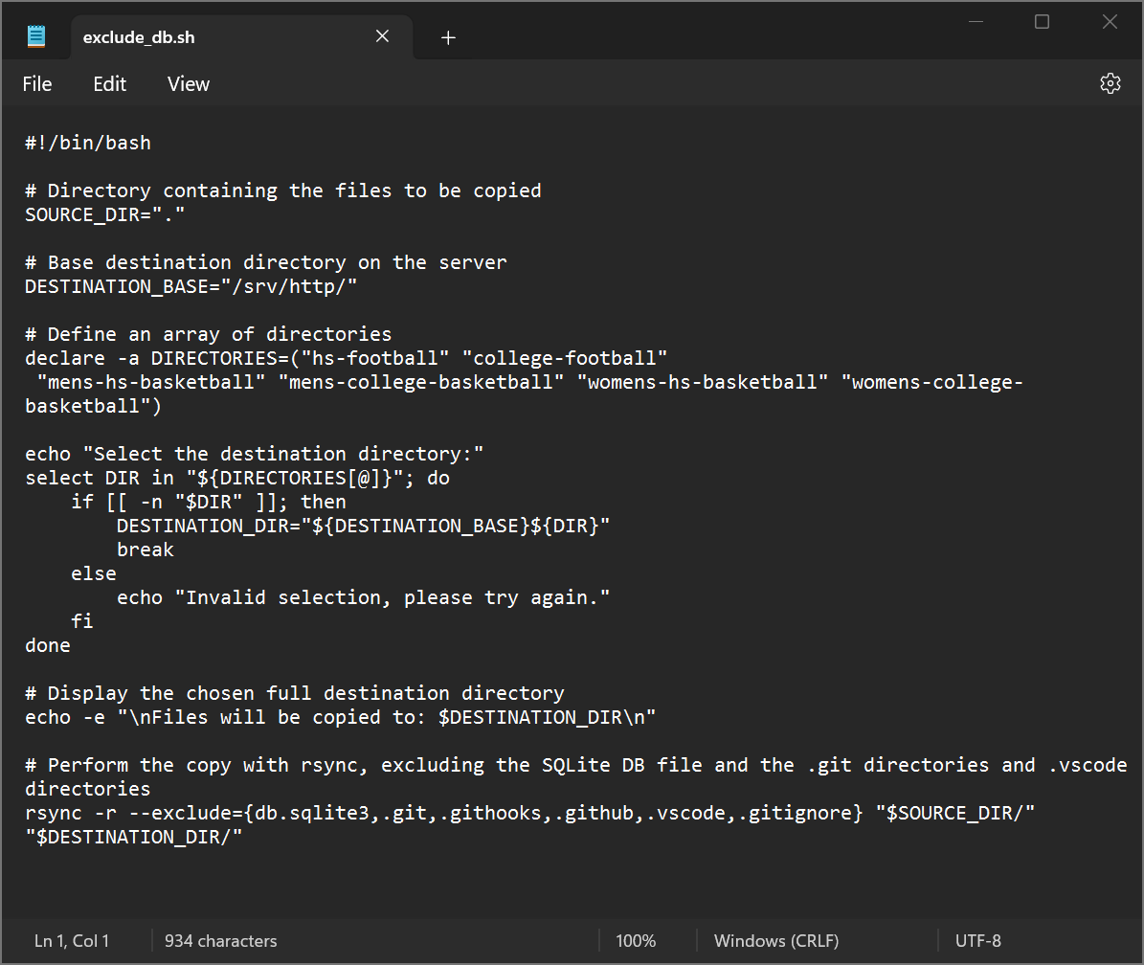
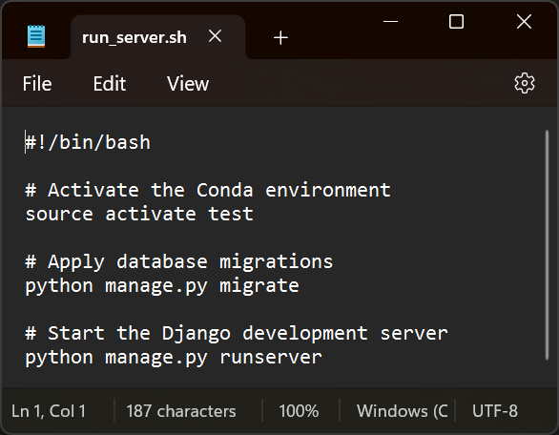
Task Automation
Bash scripts make local environment setup and server updates easier.

Slide 15

Project Updates
GitHub code backup version 1.0.0
Development branch: hs-football
Autopep8 code formatting for readability
Removal of duplicate and extraneous modules
Removal of ‘NO DATA’ lines and games graph
Inclusion of Makefile, Git Hooks, bash scripts, and robots.txt file
UML Diagrams
Coverage report capabilities
Server side backups with cron

Slide 16

Roadblocks
Inadequate developer documentation
Improper GitHub and AWS server setup
Drastic differences between GitHub and AWS server
Creating and utilizing backup data
Database data overwritten
High school football webpage rendered inoperable (numerous times)
Learning curve

Slide 17
Future Development Plans

Slide 18
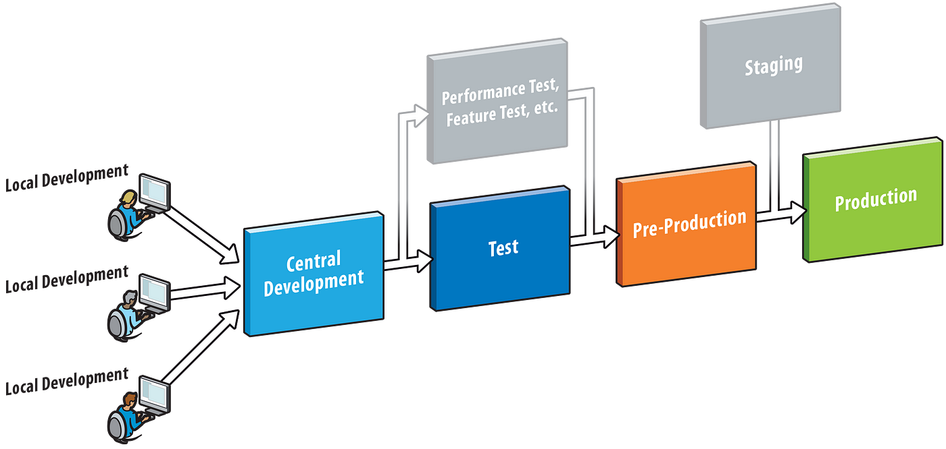
Development Environment
Utilize backup Lightsail Deployment
Synchronize Github and Development Lightsail Server
Build in Testing
Front End rebuild
ReactJS
Utilize the pieces available
Documentation
Documentation
Documentation

Slide 19
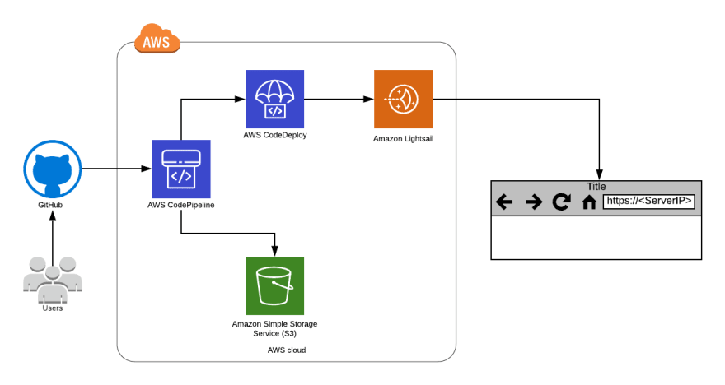
Github to Lightsail
Github issues and branching
Sandbox and testing
Local Development
Live Deployment
Prove functionality before migration/implementation

Slide 20

Testing
Isolate bugs and leaks
Developer Readability

Slide 21

Front End Rebuild
Simplify
Streamline
User Friendly
Scalable

Slide 22

Documentation
Biggest Roadblock
Future Development
Scaling and expansion

Slide 23
Conclusion
Notes:
In conclusion, our journey through this semester-long project in object-oriented programming has been enlightening and enriching. While we may not have achieved all our intended goals in fixing the website, the lessons we've learned are invaluable for our future endeavors.
One of the key takeaways has been the importance of testing. We realized that thorough testing not only helps in identifying and rectifying errors but also ensures the reliability and functionality of our codebase. Moving forward, we will prioritize comprehensive testing at every stage of development.
Documentation emerged as another crucial aspect of our project. Clear and detailed documentation not only aids in understanding our codebase but also facilitates collaboration among team members. Our experience with the lack of documentation going into this project plainly showed us the significance of maintaining up-to-date documentation for smoother workflows and knowledge sharing.
The journey from local development to deployment was a significant learning curve. We encountered challenges in understanding the deployment vs development of the app, highlighting the complexities involved in transitioning from a local environment to a live server. This experience has equipped us with a better understanding of deployment strategies, version control systems, and server configurations, which will undoubtedly benefit us in future projects.
As we reflect on this project, we acknowledge that it has laid a strong foundation for our strategy moving into the next semester in Software Engineering, where we hope to continue this project. We are committed to implementing the lessons learned, refining our development processes, and embracing a more systematic approach towards achieving our project objectives.
While this website may not be fixed, our growth in understanding and skills has been substantial. We are excited about applying our newfound knowledge and strategies to future projects, confident that we are better prepared to tackle challenges and deliver high-quality solutions.
Thank you for your attention and support throughout this journey. We look forward to showcasing our progress in the upcoming semester.

Slide 24
Thanks + Q&A

